Slide 1
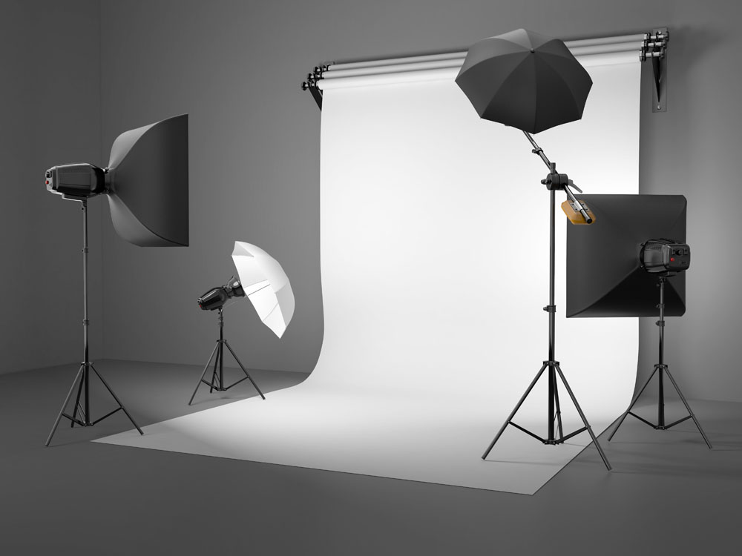
WHAT MAKES THE NEXT BLOCKBUSTER? ZHUOQUN SHENG HEYOU 11/30/2017

Slide 2
MOVIE PACKAGING- INVESTOR’S CONFUSION
In film industry terminology, movie packaging or film packaging is a type of product bundling where a top level talent agency starts up a film or television project using writers, directors and/or actors it represents, before giving other agencies a chance to submit their clients for the project.
——Wikipedia
DO THE DIRECTORES HAVE GREATER IMPACT ON BOX OFFICE?
WHAT IS THE MOST POPULAR CONTENTS RIGHT NOW?
WHICH MOVIE GENRE COULD GUARANTEE THE PROFIT?
SHOULD I FOCUS ON MOVIE’S GROSS OR THE PUBLIC PRAISE?
More info on our project at https://github.com/libbyYOU/IMDb-5000-movie-project

Slide 3
Contents
Data Preparation and Assumptions
Individual Analysis
Analysis into IMDb score
Analysis into gross
Comprehensive Analysis and Program Improvements
This is what you could hear from our presentation on the following 9 minutes.

Slide 4
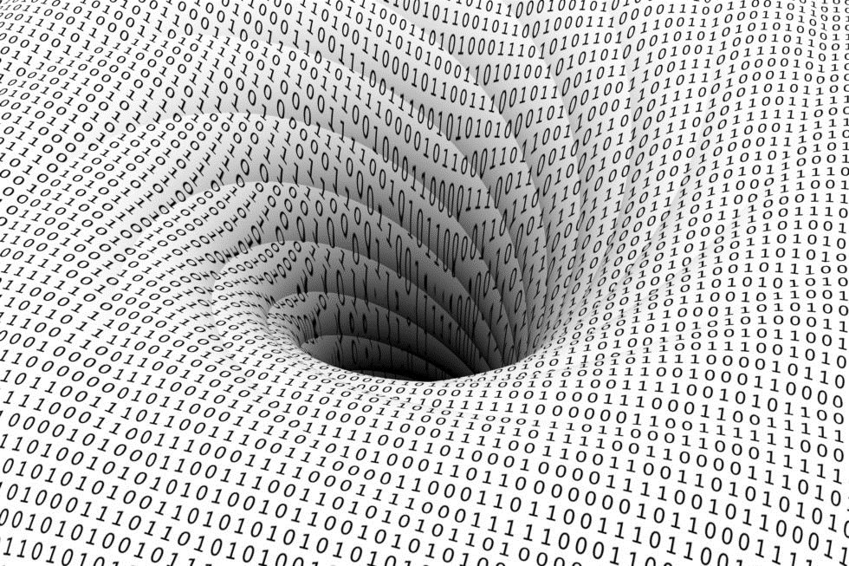
1.
DATA PREPARATION AND ASSUMPTIONS
Clean this dirty data

Slide 5

WE GET OUR DATASET FROM
IMDb data for 5000 movies was exported from Kaggle.com
2589 unique, post-2000 U.S. movie titles were analyzed
Assumptions
Gross reflects popularity in movie market
IMDb score reflects public praise

Slide 6
Dependent Variables
Independent Variables
1.
2. GROSS
IMDb Score = 1
Variable | Attribute
Budget | Numerical
Druation | Numerical
Movie Facebook Likes | Numerical
Actor 1 Facebook Likes | Numerical
Actor 2 Facebook Likes | Numerical
Actor 3 Facebook Likes | Numerical
Cast Facebook Likes | Numerical
Director Facebook Likes | Numerical
Number of Critics | Numerical
Number of Voters | Numerical
Genre | Categorical
Plot keywords | Categorical
Title year | Numerical
Actor 1 | Categorical
Actor 2 | Categorical
Actor 3 | Categorical
Director | Categorical
IMDb Score >= 7.0?
IMDb
Score = 0
👍

Slide 7
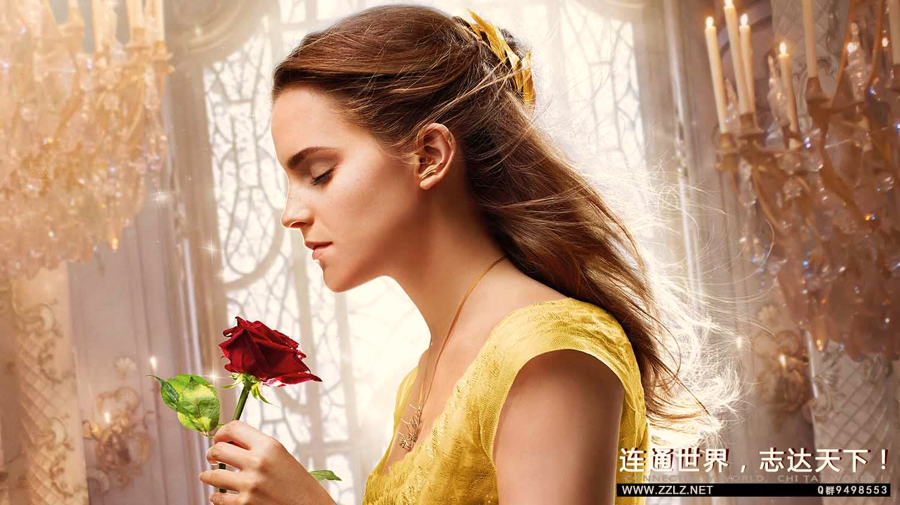
Hello!
Nice to meet you
Use the first slides to present yourself or your company. Remember that you may not be presenting this document directly.
Contact us at:
www.ourwebsite.com
hello@mail.me
@companyname

Slide 8
BIG CONCEPT
Bring the attention of your audience over a key concept using icons or illustrations

Slide 9
You can also split your content
Try to communicate ideas visually using graphs, icons, illustrations, photos… any resource that helps you convey your message at a glance.
White
Is the color of milk and fresh snow, the color produced by the combination of all the colors of the visible spectrum.
Black
Is the color of coal, ebony, and of outer space. It is the darkest color, the result of the absence of or complete absorption of light.

Slide 10
In two or three columns
Yellow
Is the color of gold, butter and ripe lemons. In the spectrum of visible light, yellow is found between green and orange.
According to surveys in Europe, Canada, and the United States, yellow is the color people most often associate with amusement, gentleness, and spontaneity, but also with duplicity, envy, jealousy, avarice, and, in the U.S., with cowardice.
It plays an important role in Asian culture, particularly in China, where it is seen as the color of happiness, glory, wisdom, harmony, and culture.
Blue
Is the colour of the clear sky and the deep sea. It is located between violet and green on the optical spectrum.
Surveys in the US and Europe show that blue is the colour most commonly associated with harmony, faithfulness, confidence, distance, infinity, the imagination, cold, and sometimes with sadness.
In US and European public opinion polls it is the most popular colour, chosen by almost half of both men and women as their favourite colour.
Red
Is the color of blood, and because of this it has historically been associated with sacrifice, danger and courage.
Modern surveys in the United States and Europe show red is also the color most commonly associated with heat, activity, passion, sexuality, anger, love and joy. Red is also a color widely used for getting attention, such as stop signs or royal dresses.
In China, India and many other Asian countries it is the color of symbolizing happiness and good fortune.

Slide 11
Quotations are commonly printed as a means of inspiration and to invoke philosophical thoughts from the reader.

Slide 12

A picture is worth a thousand words
A complex idea can be conveyed with just a single still image, namely making it possible to absorb large amounts of data quickly.

Slide 13

Want big impact? Use big image.

Slide 14
Use charts to explain your ideas
Item 1
Item 2
THE
CONCEPT
Item 3
Item 4

Slide 15
And tables to compare data
As a communication tool, a table allows a form of generalization of information from an unlimited number of different social or scientific contexts. It provides a familiar way to convey information that might otherwise not be obvious or readily understood.
 | A | B | C
Yellow | 10 | 20 | 7
Blue | 30 | 15 | 10
Orange | 5 | 24 | 16

Slide 16
Maps
our office
The word "map" comes from the medieval Latin Mappa mundi, wherein mappa meant napkin or cloth and mundi the world.

Slide 17
89,526,124
Whoa! That’s a big number, aren’t you proud?

Slide 18
And even more numbers
89,526,124$
That’s a lot of money
185,244 users
And a lot of users
100%
Total success!

Slide 19
Our process is easy
last
second
first

Slide 20
Let’s review some concepts
Yellow
Is the color of gold, butter and ripe lemons. In the spectrum of visible light, yellow is found between green and orange.
Blue
Is the colour of the clear sky and the deep sea. It is located between violet and green on the optical spectrum.
Red
Is the color of blood, and because of this it has historically been associated with sacrifice, danger and courage.
Yellow
Is the color of gold, butter and ripe lemons. In the spectrum of visible light, yellow is found between green and orange.
Blue
Is the colour of the clear sky and the deep sea. It is located between violet and green on the optical spectrum.
Red
Is the color of blood, and because of this it has historically been associated with sacrifice, danger and courage.

Slide 21
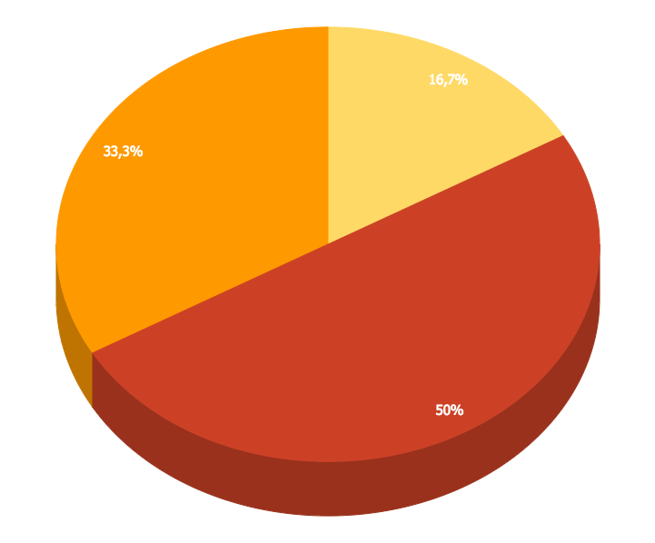
You can insert graphs from Google Sheets

Slide 22
Android Project
Place your screenshot here
Show and explain your web, app or software projects using these gadget templates.

Slide 23
iPhone Project
Place your screenshot here
Show and explain your web, app or software projects using these gadget templates.

Slide 24
Tablet
Project
Place your screenshot here
Show and explain your web, app or software projects using these gadget templates.

Slide 25
Desktop Project
Place your screenshot here
Show and explain your web, app or software projects using these gadget templates.

Slide 26

Thank you very much for your time
If you have any questions about this document please don’t hesitate to contact us at:
www.ourwebsite.com
hello@mail.me
@companyname

Slide 27
Credits
Special thanks to all the people who made and released these awesome resources for free.
Presentation template by SlidesCarnival
Photographs by Unsplash
Learn more about slidedocs at duarte.com/slidedocs

Slide 28
Presentation design
This presentation uses the following typographies and colors:
Titles: Nunito sans
Body copy: Nunito sans
Italic copy: Georgia (system font)
You can download the font on this page:
https://fontlibrary.org/en/font/nunito-sans
Orange #f67031
Yellow #ffa400
Fucsia #ed0036
You don’t need to keep this slide in your presentation. It’s only here to serve you as a design guide if you need to create new slides or download the fonts to edit the presentation in PowerPoint®

Slide 29
SlidesCarnival icons are editable shapes.
This means that you can:
Resize them without losing quality.
Change line color, width and style.
Isn’t that nice? :)
Examples:

Slide 30
😉
Now you can use any emoji as an icon!
And of course it resizes without losing quality and you can change the color.
How? Follow Google instructions https://twitter.com/googledocs/status/730087240156643328
✋👆👉👍👤👦👧👨👩👪💃🏃💑❤😂😉😋😒😭👶😸🐟🍒🍔💣📌📖🔨🎃🎈🎨🏈🏰🌏🔌🔑 and many more...

Slide 31
This template is for a SlideDoc
A slidedoc is a visual document, developed in presentation software, that is intended to be read and referenced instead of projected.
Slidedocs help you spread your smart thinking by combining visual communications with short chunks of written copy. Their scannable nature makes them great pre-read, reference, and leave-behind materials. Their modularity makes it easy for people to incorporate your ideas into their own communications. And these features together make slidedocs the perfect companion to both written documents and presentations.
Text from duarte.com/slidedocs

